Slide 1
Traffic Signal Detection
Mahmoud Abdallah
Daniel Eiland

Slide 2
Overview
The detection of traffic signals within a moving video is problematic due to issues caused by:
Low-light, Day and Night situations
Inter/Intra-frame motion
Similar light sources (such as tail lights)
These can to lead to both the detection of false signals and the inability to detect actual signals.

Slide 3
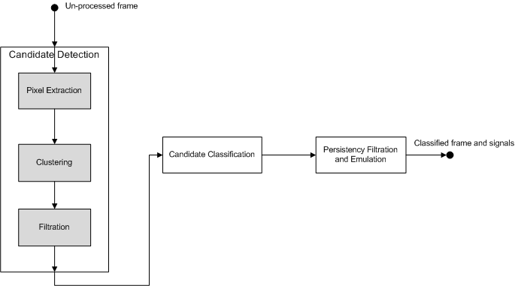
Detection Algorithm
To deal with (some of) these issues, we have developed the following 3-step algorithm:
High-level processing flow

Slide 4
Candidate Extraction
Given an input frame, the detection process begins with the extraction of candidate signals.
This is a three stage process that consists of:
Pixel Extraction – Identification of possible signal pixels based on RGB color
Clustering – Grouping of extracted pixels based on connectivity
Filtration – Removal of non-signal clusters based on
Size – Clusters must consist of an adequate number of pixels to be considered a candidate signal
Shape – Clusters must pass a circularity measure to be considered a candidate signal

Slide 5
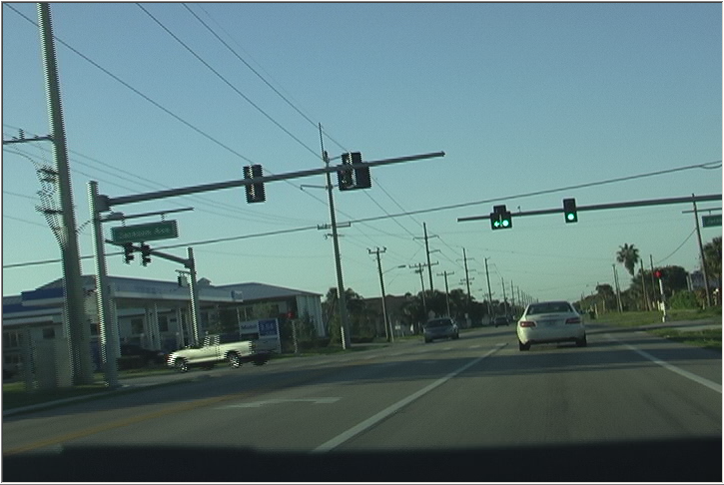
Candidate Extraction Example
Input Frame

Slide 6
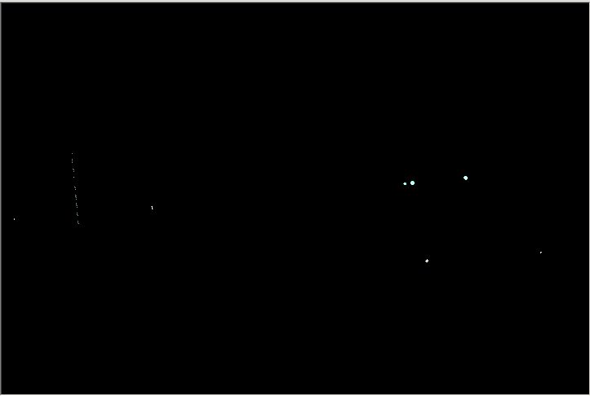
Pixel Extraction
Candidate Pixels

Slide 7
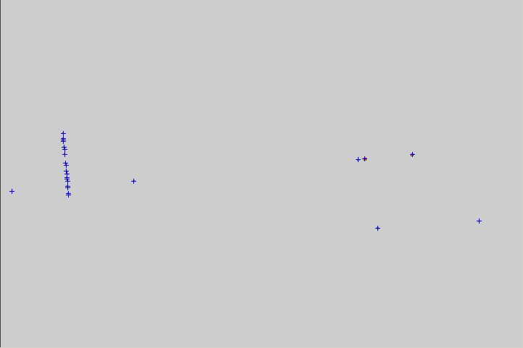
Clustering
Grouped Pixels

Slide 8

Filtration
Candidates After Size / Shape Filter

Slide 9
Candidate Classification
Once the set of candidate signals have been selected, they are classified to groups based on their relation to previously detected signals.
Candidates located near a previously detected candidate are classified as the “same” signal.
While those that cannot be mapped are classified as “new” signals and are placed into their own group.

Slide 10
Persistency Filtration and Emulation
The final processing step involves the removal of candidates that have a low detection rate; that is signals which are not detected consistently are flagged as a false-positives.
This step also emulates candidates that may not have been detected in the current frame but have been detected in previous frames.
To create emulated candidates in the proper location, the estimated motion of the signal is derived using previously detected candidates.

Slide 11
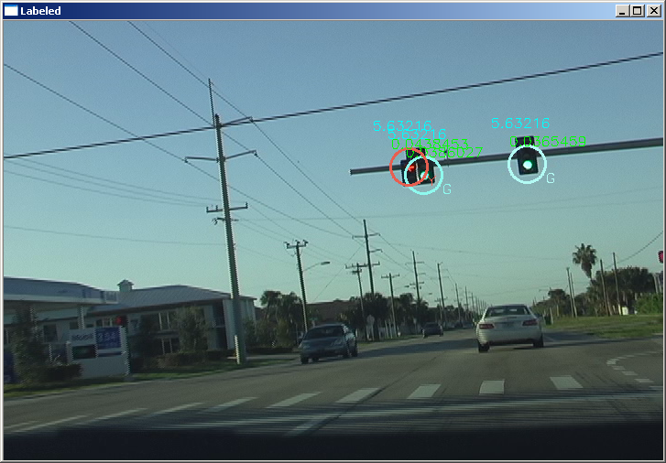
Result
Detected Signals

Slide 12
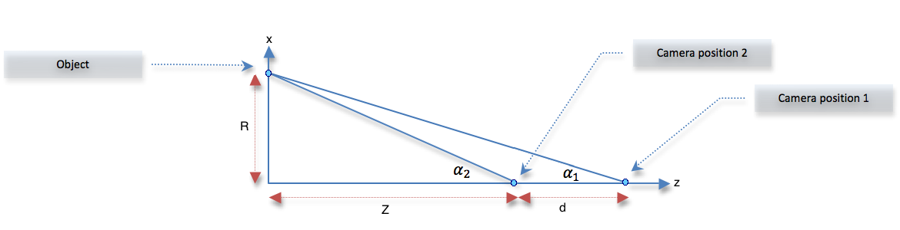
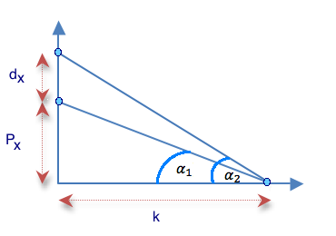
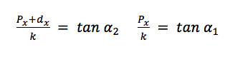
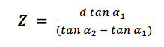
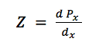
Distance Estimation

Slide 13
Future Enhancements
Additional candidate filtration metrics
“Arrow” shape detection (lack of resolution)
Neighborhood consistency: adjacent area should be dark
Signal type classification
Improve color model (HSV / HSI) to improve detection rate and allow better classification of signal color (Red, Green, Amber)
Priority classification
Detect signal that should be “followed”

Slide 14
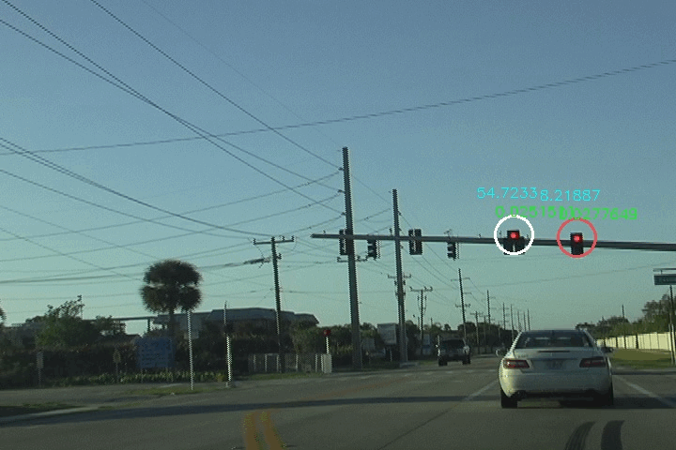
Demo

Slide 15
References
Park, J. and Chang-sung, J., “Real-time Signal Light Detection”; International Journal for Signal Processing, Image Processing and Pattern Recognition; June 2009; Vol. 2, No. 2; http://www.sersc.org/journals/IJSIP/vol2_no2/1.pdf
Chung, Y., Wang, J. and Sei-Wang, C., “A Vision-Based Traffic Light Detection System at Intersections”; Journal of Taiwan Normal University: Mathematics, Science & Technology; 2002; Vol. 47; http://wjm.tyai.tyc.edu.tw/~jmwang/paper/product/mst471-4.pdf

